Slide 1
Fixed income
Moudle1 Fixed-Income Securities : Defining Elements
Moudle2 Fixed-Income Markets : Issuance, Trading, and Funding
Moudle3 Introduction to Fixed-Income Valuation
Moudle4 Introduction to Asset-Backed Securities
Moudle5 Understanding Fixed-Income Risk and Return
Moudle6 Fundamentals of Credit Analysis

Slide 2

Module1 Fixed-Income Securities: Defining Elements
Basic Features of a Bond
Issuer
Maturity
Par or principal amount
Coupon size
Frequency
Currency

Slide 3
Module1 Fixed-Income Securities: Defining Elements
Issuer(1/6)
Supranational organizations, such as the World Bank or the European Investment Bank
Sovereign (national) governments, such as the United States or Japan
Non-sovereign (local) governments, such as the State of Minnesota in the United States, the Catalonia region in Spain
Quasi-government entities (i.e., agencies that are owned or sponsored by governments), such as postal services in many countries
Companies (i.e., corporate issuers)
Special legal entities (i.e., special purpose entities)

Slide 4
Module1 Fixed-Income Securities: Defining Elements
Market participants often classify fixed-income markets by the type of issuer, which leads to the identification of three bond market sectors:
The government and government-related sector
The corporate sector
The structured finance sector
The three largest credit rating agencies are Moody’s Investors Service, Standard& Poor’s, and Fitch Ratings
Investment-grade
Non-investment-grade/ high yield/ speculative bond

Slide 5

Module1 Fixed-Income Securities: Defining Elements
Maturity(2/6)
The maturity date of a bond refers to the date when the issuer is obligated to redeem the bond by paying the outstanding principal amount.
The tenor is the time remaining until the bond’s maturity date.
Money market security
Capital market security
Perpetual bond

Slide 6
Module1 Fixed-Income Securities: Defining Elements
Par value(3/6)
The principal amount, principal value, or simply principal of a bond is the amount that the issuer agrees to repay the bondholders on the maturity date. This amount is also referred to as the par value, or simply par, face value, nominal value, redemption value, or maturity value.
When the bond is priced at 100% of par, the bond is said to be trading at par. If the bond’s price is below 100% of par, the bond is trading at a discount. Alternatively, if the bond’s price is above 100% of par, the bond is trading at a premium.
The most common yield measure is known as the yield-to-maturity, also called the yield-to-redemption or redemption yield. The yield-to-maturity can be considered an estimate of the bond’s expected return; it reflects the annual return earned by an investor who purchases the bond today and holds it until maturity, provided they receive all promised cash flows and are able to reinvest all coupons at this same yield

Slide 7

Module1 Fixed-Income Securities: Defining Elements
Coupon rate and frequency(4/6,5/6)
Fixed rate : plain vanilla bond/conventional bond
Floating rate notes : MRR + spread
The higher the issuer’s credit quality, the lower the spread.
The MRR, however, resets periodically. Thus, as the MRR changes, the coupon rate and coupon payment change accordingly.
Zero-coupon, or pure discount bonds, are issued at a discount to par value and are redeemed at par.

Slide 8
Module1 Fixed-Income Securities: Defining Elements
Currency denomination(6/6)
Dual-currency bonds make coupon payments in one currency and pay the par value at maturity in another currency.
Currency option bonds can be viewed as a combination of a single-currency bond plus a foreign currency option. They give bondholders the right to choose the currency in which they want to receive interest payments and principal repayments. Bondholders can select one of two currencies for each payment.

Slide 9

practices
1.The risk of loss resulting from the issuer failing to make full and timely payment of interest is called:
credit risk.
systemic risk.
interest rate risk.
2.If the bond’s price is higher than its par value, the bond is trading at:
par.
a discount.
a premium.

Slide 10
practices
3.A bond has a par value of £100 and a coupon rate of 5%. Coupon payments are made semi-annually. The periodic interest payment is:
£2.50, paid twice a year.
£5.00, paid once a year.
£5.00, paid twice a year.
4.The coupon rate of a floating-rate note that makes payments in June and December is expressed as six-month MRR + 25 bps. Assuming that the six-month MRR is 3.00% at the end of June 20XX and 3.50% at the end of December 20XX, the interest rate that applies to the payment due in December 20XX is:
3.25%.
3.50%.
3.75%.

Slide 11
Module1 Fixed-Income Securities: Defining Elements
Content Of Bond Indenture
the legal identity of the bond issuer and its legal form;
the source of repayment proceeds;
the asset or collateral backing (if any);
the credit enhancements (if any); and
the covenants (if any)

Slide 12
Module1 Fixed-Income Securities: Defining Elements
Because it would be impractical for the issuer to enter into a direct agreement with each bondholder, the indenture is usually held by a trustee. The trustee is typically a financial institution acting as a fiduciary to ensure the issuer complies with the obligations specified in the indenture and to take action on behalf of the bondholders, when necessary.
Trustee’s duty:
Maintenance of required documentation and records
Appraising collateral
Invoicing the issuer for interest payments and principal repayments
Holding funds until they are paid

Slide 13
Module1 Fixed-Income Securities: Defining Elements
Legal Identity of the Bond Issuer and Its Legal Form(1/5)
Sovereign bond: Treasury (different from the body that administers the bond issue process)
Corporate bond: corporate legal entity(subsidiary of parent legal entity/holding company)
ABS: special purpose entity/special purpose vehicle(bankruptcy remoteness)

Slide 14
Module1 Fixed-Income Securities: Defining Elements
Source of repayment proceeds(2/5)
Supranational organization: repayment of previous loan/paid-in capital from members
Sovereign bond: tax/ print money/ foreign currency reserve
Non-sovereign bond: general tax/ cash flow of the project/ special tax or fees
Corporate bond: cash flow through its operation
ABS: cash flow generated by underlying financial asset

Slide 15
Module1 Fixed-Income Securities: Defining Elements
Asset or collateral backing(3/5)
Secured bond/unsecured bond
Senior debt/subordinated debt/junior debt
Debentures are a type of bond that can be secured or unsecured.
Types of collateral backing
Collateral trust bonds (backed by securities such as common shares, other bonds)
Equipment trust certificates(secured by equipment or physical asset)
ABS(mortgaged property, motor)
Covered bonds(similar to ABS but offer bondholders recourse against both the financial institution and the underlying asset pool)

Slide 16

Module1 Fixed-Income Securities: Defining Elements
Credit enhancements(4/5)
Internal credit enhancement
Subordination/credit tranching
Overcollateralizaiton
Reserve accounts(cash reserve fund/excess spread account)
External credit enhancement
Bank guarantee and surety bond
Letter of credit
Cash collateral account

Slide 17
Module1 Fixed-Income Securities: Defining Elements
Covenants(5/5)
Affirmative (positive) covenants: what issuers are required to do.
Example of affirmative covenants
The promise of making the contractual payments
Comply with all laws and regulation/maintain its current lines of business
Insure and maintain its assets/pay taxes as they come due
Pari passu (equal footing)
Cross-default

Slide 18
Module1 Fixed-Income Securities: Defining Elements
Negative covenants: what issuers are prohibited from doing.
Example of negative covenants
Restrictions on debt
Negative pledge
Restriction on prior claims
Restrictions on distribution to shareholders
Restrictions on asset disposals
Restrictions on investments
Restrictions on mergers and acquisitions

Slide 19
Module1 Fixed-Income Securities: Defining Elements
Affirmative covenants typically do not impose additional costs to the issuer and do not materially constrain the issuer’s discretion regarding how to operate its business.
In contrast, negative covenants are frequently costly and materially constrain the issuer’s potential business decisions. They protect bondholders from the dilution of their claims, asset withdrawals or substitutions, and suboptimal investments by the issuer.

Slide 20
practices
1.The major advantage of issuing bonds through a special legal entity is:
bankruptcy remoteness.
beneficial tax treatments.
greater liquidity and lower issuing costs.
2.The category of bond most likely repaid from the repayment of previous loans made by the issuer is:
sovereign bonds.
supranational bonds.
non-sovereign bonds.

Slide 21
practices
3.The external credit enhancement that has the least amount of third-party risk is a:
surety bond.
letter of credit.
cash collateral account.
4.An example of a covenant that protects bondholders against the dilution of their claims is a restriction on:
debt.
investments.
mergers and acquisitions.

Slide 22
Module1 Fixed-Income Securities: Defining Elements
Legal, regulatory, and tax consideration
A national bond market includes all the bonds that are issued and traded in a specific country and are denominated in the currency of that country.
Bonds issued by entities that are incorporated in that country are called domestic bonds, whereas bonds issued by entities that are incorporated in another country are called foreign bonds.
A Eurobond is a debt instrument that’s denominated in a currency other than the home currency of the country or market in which it is issued.
A global bond is one issued simultaneously in the Eurobond market and in at least one domestic bond market.

Slide 23
practices
1. An example of a domestic bond is a bond issued by:
LG Group from South Korea, denominated in British pounds, and sold in the United Kingdom.
The UK Debt Management Office, denominated in British pounds, and sold in the United Kingdom.
Wal-Mart from the United States, denominated in US dollars, and sold in various countries in North America, Europe, the Middle East, and Asia Pacific.
2. A bond issued by Sony in Japan, denominated in US dollars but not registered with the SEC, and sold to an institutional investor in the Middle East, is most likely an example of a:
Eurobond.
global bond.
foreign bond.

Slide 24
Module1 Fixed-Income Securities: Defining Elements
Tax Considerations
Bond interest is usually taxed at the ordinary income tax rate, which is typically the same tax rate that an individual would pay on wage or salary income.
In addition to earnings from interest, a bond investment will generate a capital gain or loss if sold prior to maturity at a price different from the purchase price.
Capital gains or losses usually face different tax treatment from taxable income, which often varies for long-term and short-term capital gains.
For bonds issued at a discount, the tax status of the original issue discount is an additional tax consideration. The United States includes a prorated portion of the discount in interest income every tax year,

Slide 25
prACTICES
Assume that a company issues bonds in the hypothetical country of Zinland, where the local currency is the zini (Z). There is an original issue discount tax provision in Zinland’s tax code. The company issues a 10-year zero-coupon bond with a par value of Z1,000 and sells it for Z800. An investor who buys the zero-coupon bond at issuance and holds it until maturity most likely:
has to include Z20 in his taxable income every tax year for 10 years and has to declare a capital gain of Z200 at maturity.
has to include Z20 in his taxable income every tax year for 10 years and does not have to declare a capital gain at maturity.
does not have to include anything in his taxable income every tax year for 10 years but has to declare a capital gain of Z200 at maturity.

Slide 26
Module1 Fixed-Income Securities: Defining Elements
Principal repayment structures(1/3)
Bullet bond
Year | Investor cash flows | Interest payment | Principal repayment | Outstanding principal at the end of the year
0 | -1000 |  |  | 1000
1 | 60 | 60 | 0 | 1000
2 | 60 | 60 | 0 | 1000
3 | 60 | 60 | 0 | 1000
4 | 60 | 60 | 0 | 1000
5 | 1060 | 60 | 1000 | 0

Slide 27
Module1 Fixed-Income Securities: Defining Elements
Principal repayment structures(2/3)
Fully amortized bond
Year | Investor cash flows | Interest payment | Principal repayment | Outstanding principal at the end of the year
0 | -1000 |  |  | 1000
1 | 237.4 | 60 | 177.4 | 822.6
2 | 237.4 | 49.36 | 188.04 | 634.56
3 | 237.4 | 38.07 | 199.32 | 435.24
4 | 237.4 | 26.11 | 211.28 | 223.96
5 | 237.4 | 13.44 | 223.96 | 0

Slide 28
Module1 Fixed-Income Securities: Defining Elements
Principal repayment structures(3/3)
Partially amortized bond
Year | Investor cash flows | Interest payment | Principal repayment | Outstanding principal at the end of the year
0 | -1000 |  |  | 1000
1 | 201.92 | 60 | 141.92 | 858.08
2 | 201.92 | 51.48 | 150.43 | 707.65
3 | 201.92 | 42.46 | 159.46 | 548.19
4 | 201.92 | 32.89 | 169.03 | 379.17
5 | 401.92 | 22.75 | 379.17 | 0

Slide 29
Module1 Fixed-Income Securities: Defining Elements
A plain vanilla bond is also known as a bullet bond because the entire payment of principal occurs at maturity.
In contrast, an amortizing bond has a payment schedule that calls for periodic payments of interest and repayments of principal.
A fully amortized bond is characterized by a fixed periodic payment schedule that reduces the bond’s outstanding principal amount to zero by the maturity date.
A partially amortized bond also makes fixed periodic payments until maturity, but only a portion of the principal is repaid by the maturity date.
Thus, a balloon payment is required at maturity to retire the bond’s outstanding principal amount.

Slide 30

Module1 Fixed-Income Securities: Defining Elements
The annual payment of fully amortized bond is constant, but over time the interest payment decreases while the principal repayment increases.
Because the principal amount is not fully amortized, interest payments are higher for the partially amortized bond than for the fully amortized bond, except the first year when they are equal.
MBS face prepayment risk, which is the possible early repayment of mortgage principal. Borrowers usually have the right to prepay mortgages, which typically occurs when a current homeowner purchases a new home or when homeowners refinance their mortgages because market interest rates have fallen.

Slide 31
Practices
1. The structure that requires the largest repayment of principal at maturity is that of a:
bullet bond.
fully amortized bond.
partially amortized bond.
2. Relative to a fully amortized bond, the coupon payments of an otherwise similar partially amortized bond are:
lower or equal.
equal.
higher or equal.

Slide 32

Module1 Fixed-Income Securities: Defining Elements
Sinking fund arrangement
A sinking fund arrangement is another approach that can be used to achieve the same goal of periodically retiring the bond’s principal outstanding.
Originally, a sinking fund was a specified cash reserve that was segregated from the rest of the issuer’s business for the purpose of repaying the principal.
More generally today, a sinking fund arrangement specifies the portion of the bond’s principal outstanding, perhaps 5%, that must be repaid each year throughout the bond’s life or after a specified date.
Another type of sinking fund arrangement operates by redeeming a steadily increasing amount of the bond’s notional principal (total amount) each year

Slide 33
Module1 Fixed-Income Securities: Defining Elements
Year | Outstanding principal at the beginning of the year | Sinking fund payment | Outstanding principal at the end of the year | Final principal repayment
0 |  |  | 200
1 to 9 | 200 | 0 | 200
10 | 200 | 10 | 190
11 | 190 | 9.5 | 180.5
12 | 180.5 | 9.03 | 171.47
13 | 171.48 | 8.57 | 162.9
14 | 162.9 | 8.15 | 154.75
15 | 154.76 | 7.74 | 147.01
16 | 147.02 | 7.35 | 139.66
17 | 139.67 | 6.98 | 132.68
18 | 132.68 | 6.63 | 126.05
19 | 126.05 | 6.3 | 119.75
20 | 119.75 |  |  | 119.75

Slide 34

Module1 Fixed-Income Securities: Defining Elements
Benefits and drawbacks of sinking fund arrangements
Reduce credit risk
Reinvestment risk
Suffer a loss if call back price below the market price

Slide 35

Module1 Fixed-Income Securities: Defining Elements
Coupon payment structures
Floating-rate notes
Step-up coupon bonds
Credit-linked coupon bonds
Payment-in-kind coupon bonds
Deferred coupon bonds
Index-linked bonds

Slide 36
Module1 Fixed-Income Securities: Defining Elements
Floating-rate notes(1/6)
Floating-rate notes do not have a fixed coupon; instead, their coupon rate is linked to an external reference rate, such as Euribor. FRNs usually pay a fixed spread over the specified reference rate.
Almost all FRNs have quarterly coupons.
FRNs have little interest rate risk.
Additional features observed in FRNs may include a floor or a cap. It is also possible to have a collared FRN, which includes both a cap and a floor.
An inverse or reverse FRN, or simply an inverse floater, is a bond whose coupon rate has an inverse relationship to the reference rate.

Slide 37
Module1 Fixed-Income Securities: Defining Elements
Step-Up Coupon Bonds(2/6)
The coupon of a step-up coupon bond, which may be fixed or floating, increases by specified margins at specified dates.
Credit-Linked Coupon Bonds(3/6)
A credit-linked coupon bond has a coupon that changes when the bond’s credit rating changes.
Payment-in-Kind Coupon Bonds(4/6)
A payment-in-kind (PIK) coupon bond typically allows the issuer to pay interest in the form of additional amounts of the bond issue rather than as a cash payment.

Slide 38
Module1 Fixed-Income Securities: Defining Elements
Deferred coupon bonds(5/6)
A deferred coupon bond, sometimes called a split coupon bond, pays no coupons for its first few years but then pays a higher coupon than it otherwise normally would for the remainder of its life.
A zero-coupon bond can be thought of as an extreme form of deferred coupon bond.

Slide 39
Module1 Fixed-Income Securities: Defining Elements
Index-linked bonds(6/6)
An index-linked bond has its coupon payments and/or principal repayment linked to a specified index. Inflation-linked bonds are an example of index-linked bonds.
Theoretically inflation-linked bonds provide investors the benefit of a long-term asset with a fixed real return that is free from inflation risk.
Zero-coupon-indexed bonds
Interest-indexed bonds
Capital-indexed bonds
Indexed-annuity bonds

Slide 40
practices
1.The bonds that do not offer protection to the investor against increases in market interest rates are:
step-up bonds.
floating-rate notes.
inverse floating-rate notes.
2.The US Treasury offers Treasury Inflation-Protected Securities (TIPS). The principal of TIPS increases with inflation and decreases with deflation based on changes in the US Consumer Price Index. When TIPS mature, an investor is paid the original principal or inflation-adjusted principal, whichever is greater. TIPS pay interest twice a year based on a fixed real coupon rate that is applied to the inflation-adjusted principal. TIPS are most likely:
capital-indexed bonds.
interest-indexed bonds.
indexed-annuity bonds.

Slide 41
practices
3.Assume a hypothetical country, Lemuria, where the national government has issued 20-year capital-indexed bonds linked to the domestic Consumer Price Index (CPI). Lemuria’s economy has been free of inflation until the most recent six months, when the CPI increased. Following the increase in inflation:
the principal amount remains unchanged but the coupon rate increases.
the coupon rate remains unchanged, but the principal amount increases.
the coupon payment remains unchanged, but the principal amount increases.

Slide 42
Module1 Fixed-Income Securities: Defining Elements
Callable and putable bond
A callable bond gives the issuer the right to redeem all or part of the bond before the specified maturity date.
A put provision gives the bondholders the right to sell the bond back to the issuer at a pre-determined price on specified dates

Slide 43
Module1 Fixed-Income Securities: Defining Elements
Callable and putable bond
 | Callable bond | Putable bond
权力归属 | 发债人买回债券 | 持有人卖回债券
行权条件 | Market price > call price Interest rate fall Credit quality improve(issuer) | Market price < put price Interest rate raise Credit quality deteriorate(issuer)
benefit | Refinance at a lower rate | Reinvestment at a higher rate
option-free bond 对比 | Lower price Higher yield | Higher price Lower yield

Slide 44
Module1 Fixed-Income Securities: Defining Elements
Callable and putable bond
The call premium is the amount over par paid by the issuer if the bond is called.
Some callable bonds are issued with a call protection period, also called lockout period, cushion, or deferment period.
The earliest time that a bond might be called is known as the call date.
American-style call, sometimes referred to as continuously callable, for which the issuer has the right to call a bond at any time starting on the first call date.
European-style call, for which the issuer has the right to call a bond only once on the call date.
Bermuda-style call, for which the issuer has the right to call bonds on specified dates following the call protection period. These dates frequently correspond to coupon payment dates.

Slide 45

Module1 Fixed-Income Securities: Defining Elements
Callable and putable bond
A typical make-whole call requires the issuer to make a lump-sum payment to the bondholders based on the present value of the future coupon payments and outstanding principal due to early bond redemption.

Slide 46
practices
Assume a hypothetical 30-year bond is issued on 15 August 2019 at a price of 98.195 (as a percentage of par). Each bond has a par value of $1,000. The bond is callable in whole or in part every 15 August from 2029 at the option of the issuer. The call prices are shown below.
Year | Call price | Year | Call price
2029 | 103.87 | 2035 | 101.548
2030 | 103.485 | 2036 | 101.161
2031 | 103 | 2037 | 100.774
2032 | 102.709 | 2038 | 100.387
2033 | 102.322 | 2039 and thereafter | 100
2034 | 101.955

Slide 47
practices
1. The call protection period is:
10 years.
11 years.
20 years.
2. The call premium (per $1,000 in par value) in 2033 is closest to:
$2.32.
$23.22.
$45.14.
3. The call provision is most likely:
a Bermuda call.
a European call.
an American call.

Slide 48

Module1 Fixed-Income Securities: Defining Elements
Convertible bond
It gives the bondholder the right to exchange the bond for a specified number of common shares in the issuing company.
The conversion price is the price per share at which the convertible bond can be converted into shares.
The conversion ratio is the number of common shares that each bond can be converted into.
The conversion value, sometimes called the parity value, is the current share price multiplied by the conversion ratio.
The conversion premium is the difference between the convertible bond’s price and its conversion value. When the conversion value is more than the price of convertible bond , the condition is above parity. In contrast, the condition is below parity.

Slide 49
Module1 Fixed-Income Securities: Defining Elements
Convertible bond
Investor’s advantage
Participate in the equity upside
Receive downside protection
Yield advantage
Issuer’s advantage
Reduce interest expense
Elimination of debt if the conversion option is exercised
Compare with option-free bond: higher price, lower yield

Slide 50
Module1 Fixed-Income Securities: Defining Elements
Convertible bond
A warrant is an “attached” rather than embedded option entitling the holder to buy the underlying stock of the issuing company at a fixed exercise price until the expiration date.
Contingent convertible bonds, nicknamed “CoCos,” are bonds with contingent write-down provisions. In the case of CoCos, conversion is automatic if a specified event occurs.

Slide 51

Practices
1. Which of the following is not an example of an embedded option?
Warrant
Call provision
Conversion provision
2. The type of bond with an embedded option that would most likely sell at a lower price than an otherwise similar bond without the embedded option is a:
putable bond.
callable bond.
convertible bond.
3. The additional risk inherent to a callable bond is best described as:
credit risk.
interest rate risk.
reinvestment risk.

Slide 52
practices
4. The put provision of a putable bond:
limits the risk to the issuer.
limits the risk to the bondholder.
does not materially affect the risk of either the issuer or the bondholder.
5. Assume that a convertible bond issued in South Korea has a par value of ₩1,000,000 and is currently priced at ₩1,100,000. The underlying share price is ₩40,000, and the conversion ratio is 25:1. The conversion condition for this bond is:
parity.
above parity.
below parity.

Slide 53
Fixed income
Moudle1 Fixed-Income Securities : Defining Elements
Moudle2 Fixed-Income Markets : Issuance, Trading, and Funding
Moudle3 Introduction to Fixed-Income Valuation
Moudle4 Introduction to Asset-Backed Securities
Moudle5 Understanding Fixed-Income Risk and Return
Moudle6 Fundamentals of Credit Analysis

Slide 54
Module2 Fixed-Income markets: issuance, trading, and funding
Classification of fixed-income markets
Classification by type of issuer
Classification by credit quality
Classification by maturity
Classification by currency denomination
Classification by type of coupon
Classification by geography
Other classifications of fixed-income markets

Slide 55
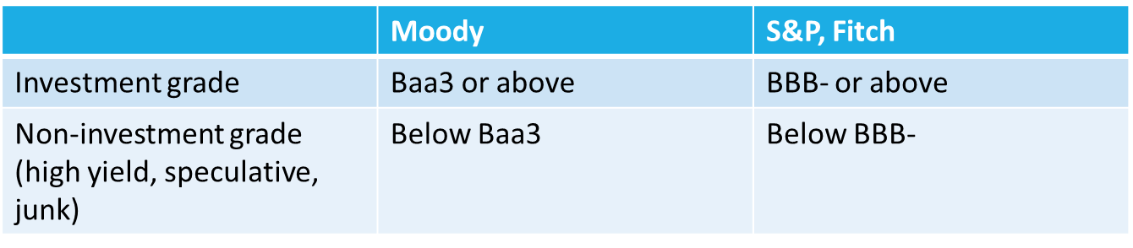
Module2 Fixed-Income markets: issuance, trading, and funding
Classification by type of issuer(1/7)
Classification by credit quality(2/7)
Global debt by sector at end of Q3 2019 in USD(USD TRILLION)
Households | Non-financial Corporates | Government | Financial Sector | Total
47.5 | 74.4 | 69.2 | 61.5 | 252.6
18.8% | 29.5% | 27.4% | 24.3% | 100%

Slide 56
Module2 Fixed-Income markets: issuance, trading, and funding
 | Moody | S&P, Fitch
Investment | Aaa | AAA
 | Aa | AA
 | A | A
 | Baa | BBB
Speculative | Ba | BB
 | B | B
 | Caa | CCC
 | Ca | CC
 | C | C
 |  | D

Slide 57
Module2 Fixed-Income markets: issuance, trading, and funding
Classification by maturity(3/7)
Money market security: overnight to one year
Capita market security: longer than one year
Classification by currency denomination(4/7)
Local currency
Foreign currency
Classification by type of coupon(5/7)
Fixed rate
Floating rate(MRR + spread)

Slide 58
Module2 Fixed-Income markets: issuance, trading, and funding
Classification by geography(6/7)
Domestic bond, foreign bond, Eurobond
Developed market, emerging market
Other classifications of fixed-income markets(7/7)
Inflation-linked bond
Tax-exempt bond

Slide 59
Module2 Fixed-Income markets: issuance, trading, and funding
Investors in fixed-income securities
Central bank
Institutional investor
Retail investor

Slide 60

practices
1.Interbank offered rates are best described as the rates at which a panel of banks can:
issue short-term debt.
borrow unsecured funds from other major banks.
borrow from other major banks against some form of collateral.
2.A company issues floating-rate bonds. The coupon rate is expressed as the three-month Libor plus a spread. The coupon payments are most likely to increase as:
Libor increases.
the spread increases.
the company’s credit quality decreases

Slide 61
practices
3. Open market operations describe the process used by central banks to buy and sell bonds to:
implement fiscal policy.
control the monetary base.
issue and repay government debt.
4. Retail investors most often:
do not invest in fixed-income securities.
invest directly in fixed-income securities.
invest indirectly in fixed-income securities through mutual funds or exchange-traded funds.

Slide 62
Module2 Fixed-Income markets: issuance, trading, and funding
Primary and secondary bond markets
Primary bond markets are markets in which issuers initially sell bonds to investors to raise capital.
Secondary bond markets are markets in which existing bonds are subsequently traded among investors.

Slide 63
Module2 Fixed-Income markets: issuance, trading, and funding
Primary bond markets
Public offering
Underwritten offering(firm commitment offering)
Best-efforts offering
Shelf registration
auction
Private placement

Slide 64
Module2 Fixed-Income markets: issuance, trading, and funding
Auction
The public auction process used in the United States is a single-price auction through which all the winning bidders pay the same price and receive the same coupon rate for the bonds.
Competitive bid
Non-competitive bid
Most US Treasury securities are bought at auction by primary dealers.

Slide 65
Module2 Fixed-Income markets: issuance, trading, and funding
Auction
竞标利率 | 竞标金额
1.52% | 2,000,000,000
1.60% | 3,000,000,000
1.62% | 1,500,000,000
1.74% | 2,500,000,000
1.79% | 500,000,000
1.83% | 800,000,000
1.86% | 1,000,000,000

Slide 66
Module2 Fixed-Income markets: issuance, trading, and funding
Secondary bond markets
There are three main ways for secondary markets to be structured: as an organized exchange, as an over-the-counter market, or as a bond tender offer.
In a liquid market, trading takes place quickly at prices close to the security’s fair market value. A key indicator and measurement of liquidity is the bid–offer spread or bid–ask spread.
Secondary market settlement for government and quasi-government bonds typically takes place either on a cash basis or on a T + 1 basis. Corporate bonds usually settle on a T + 2 or T + 3 basis.

Slide 67
practices
1.In a single-price bond auction, an investor who places a competitive bid and specifies a rate that is above the rate determined at auction will most likely:
not receive any bonds.
receive the bonds at the rate determined at auction.
receive the bonds at the rate specified in the investor’s competitive bid.
2.A bond purchased in a secondary market is most likely purchased from:
the bond’s issuer.
the bond’s lead underwriter.
another investor in the bond.

Slide 68
Module2 Fixed-Income markets: issuance, trading, and funding
Sovereign bonds
US government bond
T-bills(Treasury bills): original maturity is on year or shorter
T-notes(Treasury notes): original maturity is longer than one year and up to 10years
T-bonds(Treasury bonds):original maturity is longer than 10 years
Money market securities(T-bills) are pure discount bonds.
Capital market securities(T-notes and T-bonds) are typically coupon (or coupon-bearing) bonds.
The majority of the trading in secondary markets is of sovereign securities that were most recently issued, called on-the-run securities

Slide 69
Module2 Fixed-Income markets: issuance, trading, and funding
Credit quality of sovereign bonds
Highly rated sovereign bonds denominated in local currency are virtually free of credit risk.
Thus, it is common to observe a higher credit rating for sovereign bonds issued in local currency than for those issued in a foreign currency.

Slide 70
Module2 Fixed-Income markets: issuance, trading, and funding
Types of Sovereign Bonds
Fixed-rate bonds
Zero-coupon bonds
Coupon bonds
Floating-rate bonds
Inflation-linked bonds

Slide 71
practices
1.Floating-rate bonds are issued by national governments as the best way to reduce:
credit risk.
inflation risk.
interest rate risk.
2.Sovereign bonds whose coupon payments and/or principal repayments are adjusted by a consumer price index are most likely known as:
linkers.
floaters.
consols.

Slide 72
Module2 Fixed-Income markets: issuance, trading, and funding
Non-Sovereign Bonds
The source for repaying interest and principal: taxing authority, cash flow of project , special tax and fee.
Non-sovereign bonds usually trade at a higher yield and lower price than sovereign bonds with similar characteristics.
Quasi-Government Bonds
Federal National Mortgage Association, Federal Home Loan Mortgage Corporation
Bonds are repaid from the cash flows generated by the entity or from the project the bond issue is financing
Quasi-government bonds are usually rated very high by the credit rating agencies

Slide 73
Practices
1.Relative to sovereign bonds, non-sovereign bonds with similar characteristics most likely trade at a yield that is:
lower.
the same.
higher.
2. Bonds issued by a governmental agency are most likely:
repaid from the cash flows generated by the agency.
guaranteed by the national government that sponsored the agency.
backed by the taxing power of the national government that sponsored the agency.

Slide 74

Module2 Fixed-Income markets: issuance, trading, and funding
Corporate debt
Bank loan
Bilateral loan
Syndicated loan
Commercial paper
Notes and bonds

Slide 75
Module2 Fixed-Income markets: issuance, trading, and funding
Commercial paper
Commercial paper is a short-term, unsecured promissory note.
The maturity of commercial paper can range from overnight to one year, but a typical issue matures in less than three months.
Commercial paper issuers secure a backup line of credit from banks.
Commercial paper is a source of funding for working capital and seasonal demands for cash. It is also a source of bridge financing.

Slide 76
Module2 Fixed-Income markets: issuance, trading, and funding
Commercial paper
Feature | US commercial paper | Euro commercial paper
Currency | Us dollar | Any currency
Maturity | Overnight to 270days | Overnight to 364days
Interest | Discount | Interest-bearing or discount
Settlement | T+0 | T+2

Slide 77

Module2 Fixed-Income markets: issuance, trading, and funding
Notes and bonds
Maturities
Those securities with maturities between 1 and 12 years are often considered notes, whereas securities with maturities greater than 12 years are considered bonds.
Medium-term note(MTN)
Coupon payment structures

Slide 78

Module2 Fixed-Income markets: issuance, trading, and funding
Notes and bonds
Principal Repayment Structures
With a serial maturity structure, the maturity dates are spread out during the bond’s life; a stated number of bonds mature and are paid off each year before final maturity. With a term maturity structure, the bond’s notional principal is paid off in a lump sum at maturity.
Asset or Collateral Backing
Contingency Provisions

Slide 79
Practices
1.A loan made by a group of banks to a private company is most likely:
a bilateral loan.
a syndicated loan.
a securitized loan.
Which of the following statements relating to commercial paper is most accurate? Companies issue commercial paper:
only for funding working capital.
only as an interim source of financing.
both for funding working capital and as an interim source of funding.

Slide 80

Practices
3.Maturities of Eurocommercial paper range from:
overnight to three months.
overnight to one year.
three months to one year.
4. A bond issue that has a stated number of bonds that mature and are paid off each year before final maturity most likely has a:
term maturity.
serial maturity.
sinking fund arrangement.

Slide 81
Module2 Fixed-Income markets: issuance, trading, and funding
Short-term bank funding alternatives
Retail market
Retail deposit
Deposit account
Saving account
Money market account
Short-term Wholesale market
Reserve fund
Interbank fund
Certificate of deposit

Slide 82

Module2 Fixed-Income markets: issuance, trading, and funding
Reserve fund
Some banks have an excess over the minimum required funds to be held in reserve. At the same time, other banks run short of required reserves. This imbalance is solved through the central bank funds market, which allows banks that have a surplus of funds to lend money to banks that need funds for maturities of up to one year.
These rates are termed the central bank funds rates.

Slide 83
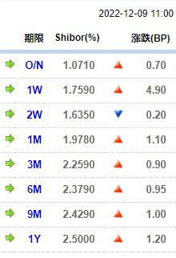
Module2 Fixed-Income markets: issuance, trading, and funding
Interbank Funds
The interbank market is the market of
loans and deposits between banks.
Certificate of deposit
Non-negotiable CD
Negotiable CD
Large-denomination CD
Small-denomination CD

Slide 84
Module2 Fixed-Income markets: issuance, trading, and funding
Repurchase and reverse repurchase agreement
A repurchase agreement or repo is the sale of a security with a simultaneous agreement by the seller to buy the same security back from the purchaser at an agreed-on price and future date.
The price at which the dealer repurchases the security is known as the repurchase price.
The date when the gilt is repurchased is called the repurchase date.

Slide 85

Module2 Fixed-Income markets: issuance, trading, and funding
Repurchase and reverse repurchase agreement
The interest rate on a repurchase agreement is called the repo rate.
Repo rate is lower when:
The collateral is highly rated
Short term maturity
Delivery of collateral to the lender is required
high demand and short supply of collateral
The interest rates of alternative financing in the money market is lower

Slide 86
Module2 Fixed-Income markets: issuance, trading, and funding
Repurchase and reverse repurchase agreement
Both parties to a repurchase agreement are subject to credit risk.
The difference between the market value of the security used as collateral and the value of the loan is known as the repo margin, although the term haircut is more commonly used, particularly in the United States.
Rope margin is lower when:
The shorter length of repurchase agreement
The higher quality of the collateral
The higher creditworthiness of the counterparty
High demand and short supply of the collateral

Slide 87
practices
1.A large-denomination negotiable certificate of deposit most likely:
is traded in the open market.
is purchased by retail investors.
has a penalty for early withdrawal of funds.
2.From the dealer’s viewpoint, a repurchase agreement is best described as a type of:
collateralized short-term lending.
collateralized short-term borrowing.
uncollateralized short-term borrowing.

Slide 88
practices
3.The interest on a repurchase agreement is known as the:
repo rate.
repo yield.
Repo margin.
4.The level of repo margin is higher:
the higher the quality of the collateral.
the higher the credit quality of the counterparty.
the longer the length of the repurchase agreement.

Slide 89

Module2 Fixed-Income markets: issuance, trading, and funding
Structured financial instruments
This sector includes asset-backed securities (ABS) and collateralized debt obligations (CDOs).
Capital protected instruments(guarantee certificate)
Yield enhancement instruments(credit linked note)
Participation instruments(floating rate bond)
Leveraged instruments(inverse floater bond)

Slide 90
practices
1.If an investor holds a credit-linked note and the credit event does not occur, the investor receives:
all promised cash flows as scheduled.
all coupon payments as scheduled but not the par value at maturity.
all coupon payments as scheduled and the par value minus the nominal value of the reference asset to which the credit-linked note is linked at maturity.
2.A structured financial instrument whose coupon rate is determined by the formula 5% – (0.5 × Libor) is most likely:
a leveraged inverse floater.
a participation instrument.
a deleveraged inverse floater.

Slide 91
Fixed income
Moudle1 Fixed-Income Securities : Defining Elements
Moudle2 Fixed-Income Markets : Issuance, Trading, and Funding
Moudle3 Introduction to Fixed-Income Valuation
Moudle4 Introduction to Asset-Backed Securities
Moudle5 Understanding Fixed-Income Risk and Return
Moudle6 Fundamentals of Credit Analysis

Slide 92
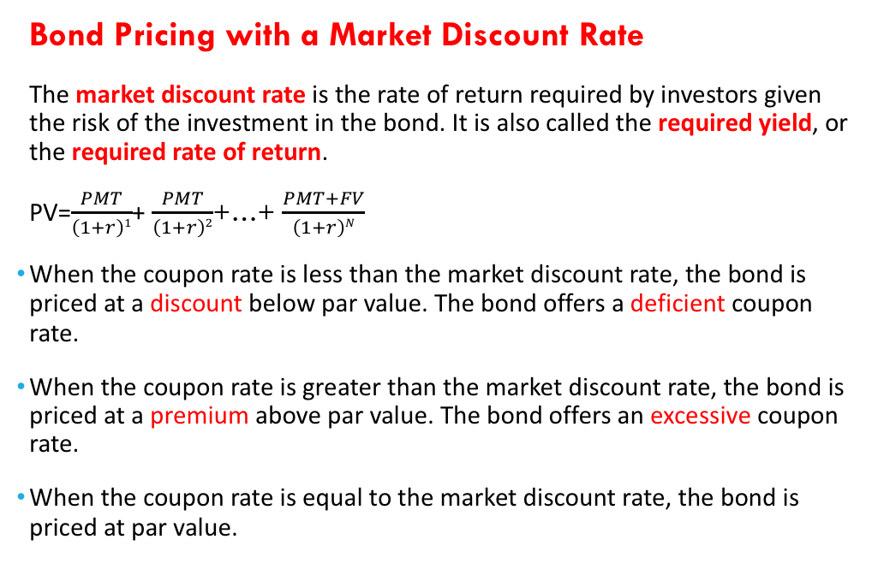
Module3 Introduction to fixed-income valuation
Bond Pricing with a Market Discount Rate
The market discount rate is the rate of return required by investors given the risk of the investment in the bond. It is also called the required yield, or the required rate of return.
PV=$\frac{PMT}{\left(1+r\right)1}$+ $\frac{PMT}{\left(1+r\right)2}$+…+ $\frac{PMT+FV}{\left(1+r\right)N}$
When the coupon rate is less than the market discount rate, the bond is priced at a discount below par value. The bond offers a deficient coupon rate.
When the coupon rate is greater than the market discount rate, the bond is priced at a premium above par value. The bond offers an excessive coupon rate.
When the coupon rate is equal to the market discount rate, the bond is priced at par value.

Slide 93
Module3 Introduction to fixed-income valuation
Yield-to-Maturity
The yield-to-maturity is the internal rate of return on the cash flows—the uniform interest rate such that when the future cash flows are discounted at that rate, the sum of the present values equals the price of the bond. It is the implied market discount rate.
Three critical assumption:
The investor holds the bond to maturity.
The issuer makes all the coupon and principal payments in the full amount on the scheduled dates.
The investor is able to reinvest coupon payments at that same yield.

Slide 94
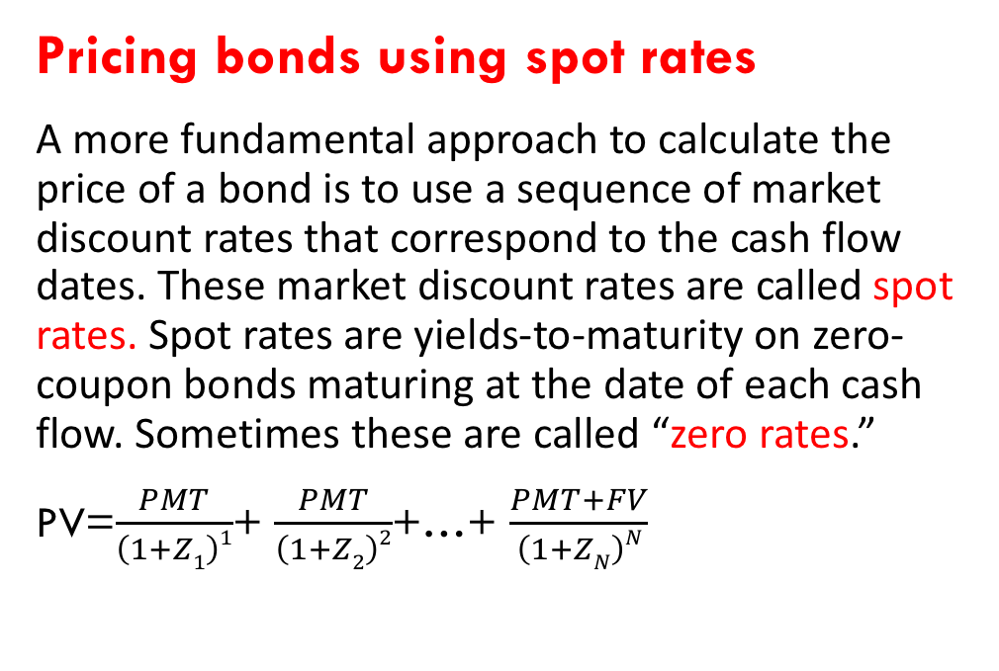
Module3 Introduction to fixed-income valuation
Pricing bonds using spot rates
A more fundamental approach to calculate the price of a bond is to use a sequence of market discount rates that correspond to the cash flow dates. These market discount rates are called spot rates. Spot rates are yields-to-maturity on zero-coupon bonds maturing at the date of each cash flow. Sometimes these are called “zero rates.”
PV=$\frac{PMT}{\left(1+Z1\right)1}$+ $\frac{PMT}{\left(1+Z2\right)2}$+…+ $\frac{PMT+FV}{\left(1+ZN\right)N}$

Slide 95
Module3 Introduction to fixed-income valuation
Relationships between the Bond Price and Bond Characteristics
Bond | Coupon Rate | Maturity | Price at 20% | Price at 19% | % Change | Price at 21% | % Change
A | 10% | 10 | 58.075 | 60.950 | 4.95% | 55.405 | -4.6%
B | 20% | 10 | 100 | 104.339 | 4.34% | 95.946 | -4.05%
C | 30% | 10 | 141.925 | 147.728 | 4.09% | 136.487 | -3.83%
D | 10% | 20 | 51.304 | 54.092 | 5.43% | 48.776 | -4.93%
E | 20% | 20 | 100 | 105.101 | 5.10% | 95.343 | -4.66%
F | 30% | 20 | 148.696 | 156.109 | 4.99% | 141.910 | -4.56%
G | 10% | 30 | 50.211 | 52.888 | 5.33% | 47.791 | -4.82%
H | 20% | 30 | 100 | 105.235 | 5.23% | 95.254 | -4.75%
I | 30% | 30 | 149.789 | 157.581 | 5.20% | 142.716 | -4.72%

Slide 96
Module3 Introduction to fixed-income valuation
The bond price is inversely related to the market discount rate. When the market discount rate increases, the bond price decreases (the inverse effect).
For the same coupon rate and time-to-maturity, the percentage price change is greater (in absolute value, meaning without regard to the sign of the change) when the market discount rate goes down than when it goes up (the convexity effect).
For the same time-to-maturity, a lower-coupon bond has a greater percent- age price change than a higher-coupon bond when their market discount rates change by the same amount (the coupon effect).
Generally, for the same coupon rate, a longer-term bond has a greater per- centage price change than a shorter-term bond when their market discount rates change by the same amount (the maturity effect).

Slide 97
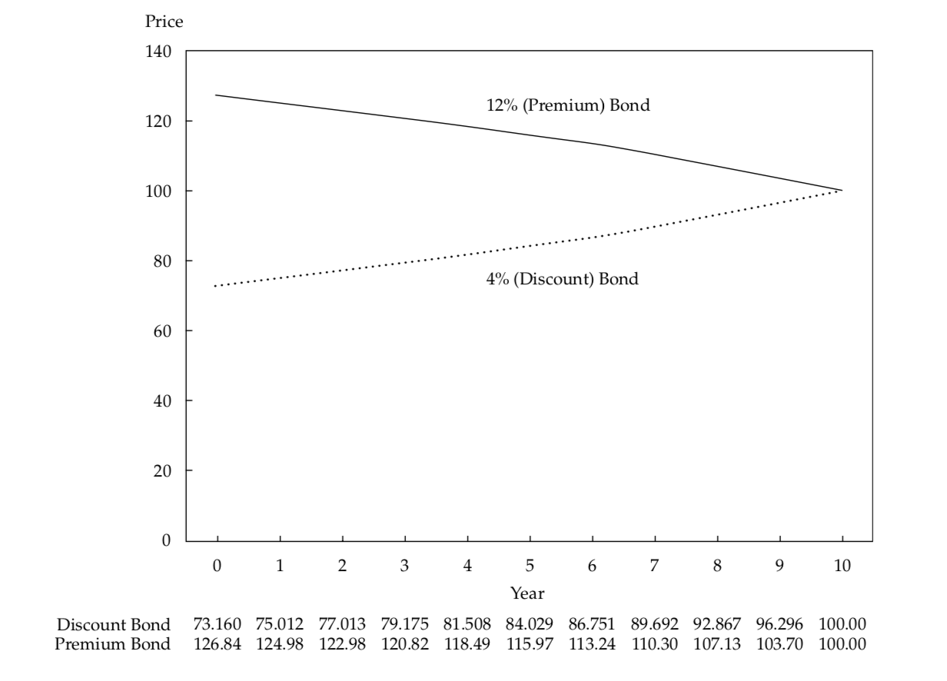
Module3 Introduction to fixed-income valuation
If the issuer does not default, the price of a bond approaches par value as its time-to-maturity approaches zero.

Slide 98
practices
Bond | Coupon rate | Time to maturity | Yield to maturity
A | 0% | 2y | 5%
B | 5% | 2y | 5%
C | 8% | 2y | 5%
D | 0% | 4y | 5%
E | 5% | 4y | 5%
F | 8% | 4y | 5%
An investor is considering the following six annual coupon payment government bonds:
1. Based on the relationships between bond prices and bond characteristics, which bond will go up in price the most on a percentage basis if all yields go down from 5.00% to 4.90%?
2. Based on the relationships between the bond prices and bond characteristics, which bond will go down in price the least on a percentage basis if all yields go up from 5.00% to 5.10%?

Slide 99
Module3 Introduction to fixed-income valuation
Flat Price, Accrued Interest, and the Full Price
When a bond is between coupon payment dates, its price has two parts: the flat price (PV^{Flat}) and the accrued interest (AI). The sum of the parts is the full price (PV^{Full}), which also is called the invoice or “dirty” price. The flat price, which is the full price minus the accrued interest, is also called the quoted or “clean” price.
PV^{Full} = PV^{Flat} + AI.
Accrued interest is the proportional share of the next coupon payment. Assume that the coupon period has “T” days between payment dates and that “t” days have gone by since the last payment.
AI = t/T × PMT

Slide 100
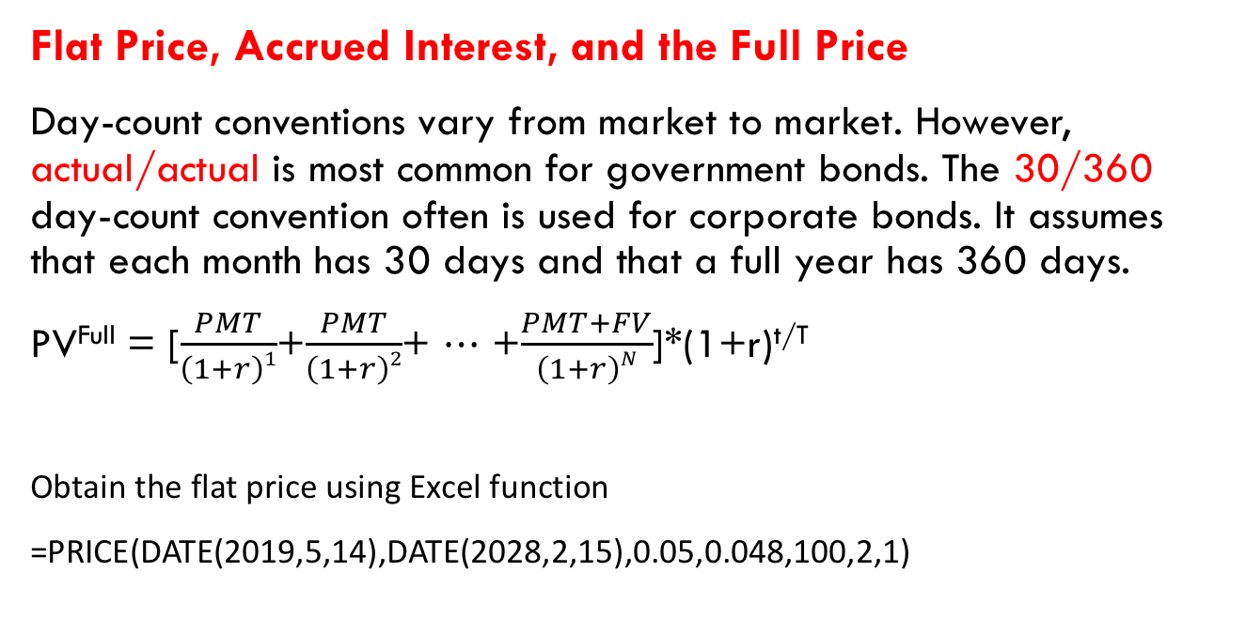
Module3 Introduction to fixed-income valuation
Flat Price, Accrued Interest, and the Full Price
Day-count conventions vary from market to market. However, actual/actual is most common for government bonds. The 30/360 day-count convention often is used for corporate bonds. It assumes that each month has 30 days and that a full year has 360 days.
PV^{Full} = [$\frac{PMT}{\left(1+r\right)1}$+$\frac{PMT}{\left(1+r\right)2}$+ ⋯ +$\frac{PMT+FV}{\left(1+r\right)N}$]*(1+r)^{t/T}
Obtain the flat price using Excel function
=PRICE(DATE(2019,5,14),DATE(2028,2,15),0.05,0.048,100,2,1)

Slide 101
practices
A 6% German corporate bond is priced for settlement on 18 June 2019. The bond makes semiannual coupon payments on 19 March and 19 September of each year and matures on 19 September 2030. The corporate bond uses the 30/360 day-count convention for accrued interest. Calculate the full price, the accrued interest, and the flat price per EUR100 of par value for annual yields-to-maturity: 6.00%.

Slide 102
Module3 Introduction to fixed-income valuation
Matrix Pricing
An analyst needs to value a three-year, 4% semiannual coupon payment corporate bond, Bond X. Assume that Bond X is not actively traded and that there are no recent transactions reported for this particular security. However, there are quoted prices for four corporate bonds that have very similar credit quality:
Bond A: Two-year, 3% semiannual coupon payment bond trading at a price of 98.500
Bond B: Two-year, 5% semiannual coupon payment bond trading at a price of 102.250
Bond C: Five-year, 2% semiannual coupon payment bond trading at a price of 90.250
Bond D: Five-year, 4% semiannual coupon payment bond trading at a price of 99.125

Slide 103
Module3 Introduction to fixed-income valuation
Matrix Pricing
 | 2% coupon | 3% coupon | 4% coupon | 5% coupon
Two years |  | BOND A 3.786% |  | BOND B 3.821%
Three years |  |  | BOND X
Four years
Five years | BOND C 4.181% |  | BOND D 4.196%

Slide 104
practices
An analyst needs to assign a value to an illiquid four-year, 4.5% annual coupon payment corporate bond. The analyst identifies two corporate bonds that have similar credit quality: One is a three-year, 5.50% annual coupon payment bond priced at 107.500 per 100 of par value, and the other is a five-year, 4.50% annual coupon payment bond priced at 104.750 per 100 of par value. Using matrix pricing, the estimated price of the illiquid bond per 100 of par value is closest to:
A. 103.895.
B. 104.991.
C. 106.125.

Slide 105

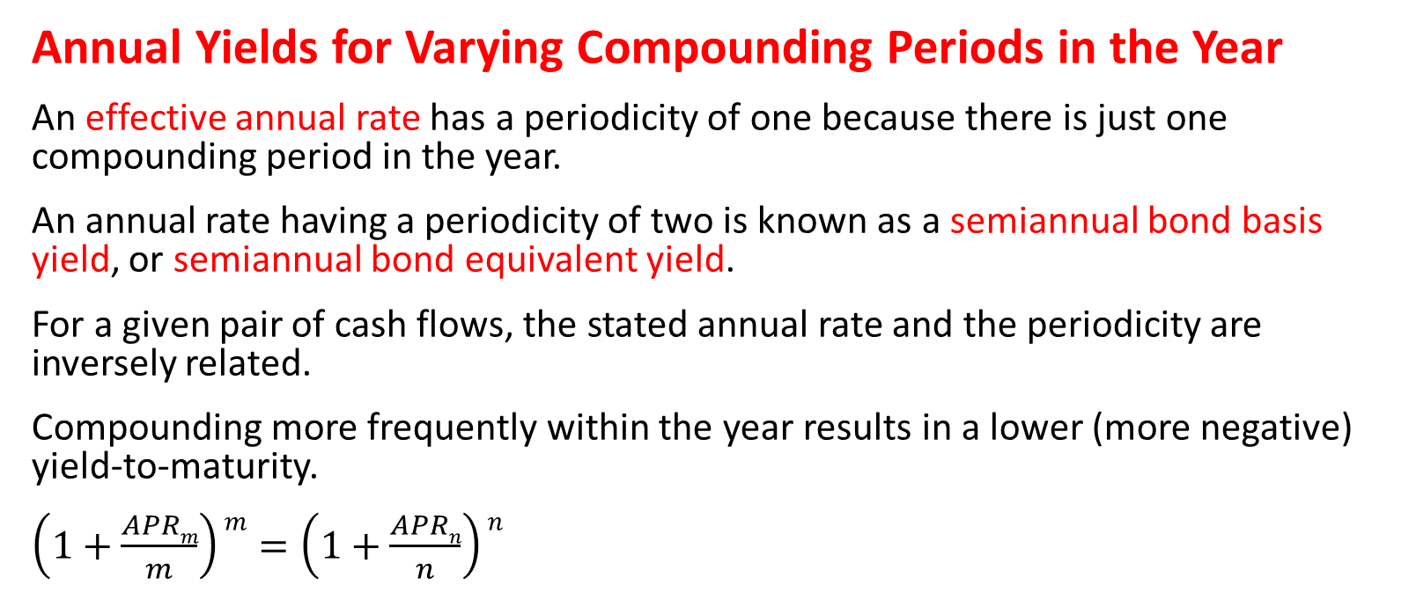
Module3 Introduction to fixed-income valuation
Annual Yields for Varying Compounding Periods in the Year
An effective annual rate has a periodicity of one because there is just one compounding period in the year.
An annual rate having a periodicity of two is known as a semiannual bond basis yield, or semiannual bond equivalent yield.
For a given pair of cash flows, the stated annual rate and the periodicity are inversely related.
Compounding more frequently within the year results in a lower (more negative) yield-to-maturity.
$\left(1+\frac{APRm}{m}\right)m=\left(1+\frac{APRn}{n}\right)n$

Slide 106
practices
A five-year, 4.50% semiannual coupon payment government bond is priced at 98 per 100 of par value. Calculate the annual yield-to-maturity stated on a semiannual bond basis, rounded to the nearest basis point. Convert that annual yield to
A. an annual rate that can be used for direct comparison with otherwise comparable bonds that make quarterly coupon payments and
B. an annual rate that can be used for direct comparison with otherwise comparable bonds that make annual coupon payments.

Slide 107
Module3 Introduction to fixed-income valuation
Yield measures for fixed-rate bonds
Yield measures that neglect weekends and holidays are quoted on what is called street convention. The street convention yield-to-maturity is the internal rate of return on the cash flows assuming the payments are made on the scheduled dates.
Sometimes the true yield is also quoted. The true yield-to-maturity is the internal rate of return on the cash flows using the actual calendar of weekends and bank holidays.

Slide 108

Module3 Introduction to fixed-income valuation
Yield measures for fixed-rate bonds
Another yield measure that is commonly quoted for fixed-income bonds is the current yield, also called the income or running yield. The current yield is the sum of the coupon payments received over the year divided by the flat price.
Sometimes the simple yield on a bond is quoted. It is the sum of the coupon payments plus the straight-line amortized share of the gain or loss, divided by the flat price.

Slide 109

Module3 Introduction to fixed-income valuation
Yield measures for fixed-rate bonds
The lowest of the sequence of yields-to-call and the yield-to-maturity is known as the yield-to-worst.
V _{callable bond} = V _{option-free bond} – V _{call option}
V _{option-free bond} = V _{callable bond} + V _{call option}
The option-adjusted yield on a callable bond is the yield-to-maturity after adding the theoretical value of the call option to the price.
V _{putable bond} = V _{option-free bond} + V _{put option}
V _{option-free bond} = V _{putable bond} – V _{put option}
The option-adjusted yield on a putable bond is the yield-to-maturity after subtracting the theoretical value of the put option to the price.

Slide 110
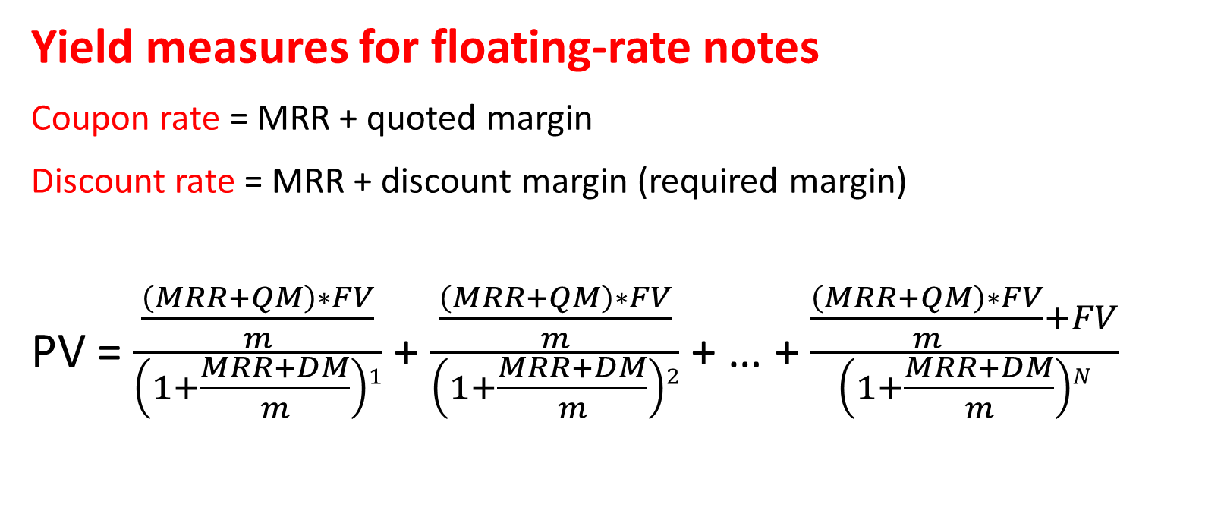
Module3 Introduction to fixed-income valuation
Yield measures for floating-rate notes
Coupon rate = MRR + quoted margin
Discount rate = MRR + discount margin (required margin)
PV = $\frac{\frac{\left(MRR+QM\right)∗FV}{m}}{\left(1+\frac{MRR+DM}{m}\right)1}$ + $\frac{\frac{\left(MRR+QM\right)∗FV}{m}}{\left(1+\frac{MRR+DM}{m}\right)2}$ + … + $\frac{\frac{\left(MRR+QM\right)∗FV}{m}+FV}{\left(1+\frac{MRR+DM}{m}\right)N}$

Slide 111
Module3 Introduction to fixed-income valuation
Yield measures for floating-rate notes
This is a simplified FRN pricing model, for several reasons:
First, PV is for a rate reset date when there are N evenly spaced periods to maturity. There is no accrued interest so that the flat price is the full price.
Second, the model assumes a 30/360 day-count convention so that the periodicity is an integer.
Third, and most important, the same reference rate (Index) is used for all payment periods in both the numerators and denominators.

Slide 112
practices
A four-year French floating-rate note pays three-month Euribor (Euro Interbank Offered Rate, an index produced by the European Banking Federation) plus 1.25%. The floater is priced at 98 per 100 of par value. Calculate the discount margin for the floater assuming that three-month Euribor is constant at 2%. Assume the 30/360 day-count convention and evenly spaced periods.

Slide 113
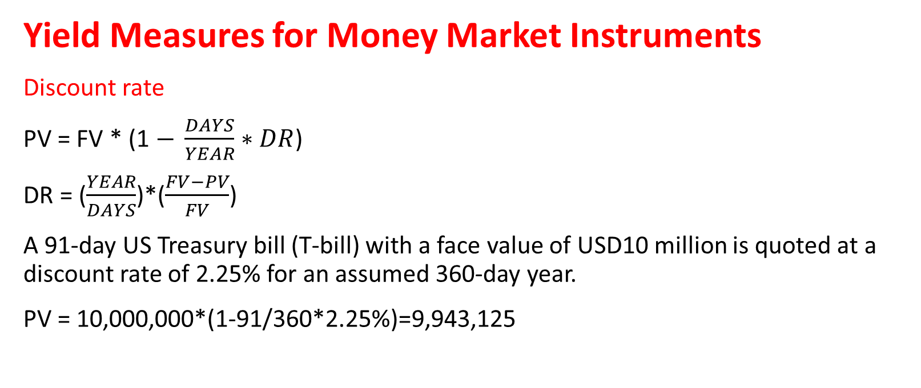
Module3 Introduction to fixed-income valuation
Yield Measures for Money Market Instruments
Discount rate
PV = FV * (1 $− \frac{DAYS}{YEAR}∗DR$)
DR = ($\frac{YEAR}{DAYS}$)*($\frac{FV−PV}{FV}$)
A 91-day US Treasury bill (T-bill) with a face value of USD10 million is quoted at a discount rate of 2.25% for an assumed 360-day year.
PV = 10,000,000*(1-91/360*2.25%)=9,943,125

Slide 114
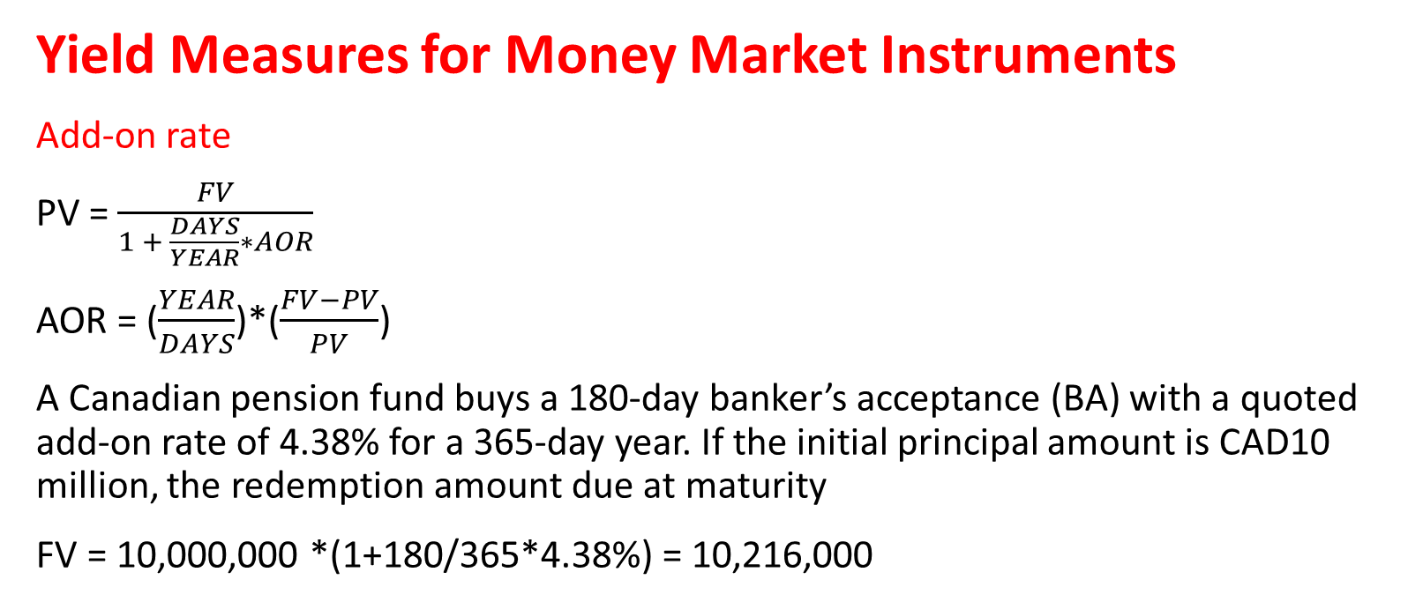
Module3 Introduction to fixed-income valuation
Yield Measures for Money Market Instruments
Add-on rate
PV = $\frac{FV}{1 + \frac{DAYS}{YEAR}∗AOR}$
AOR = ($\frac{YEAR}{DAYS}$)*($\frac{FV−PV}{PV}$)
A Canadian pension fund buys a 180-day banker’s acceptance (BA) with a quoted add-on rate of 4.38% for a 365-day year. If the initial principal amount is CAD10 million, the redemption amount due at maturity
FV = 10,000,000 *(1+180/365*4.38%) = 10,216,000

Slide 115
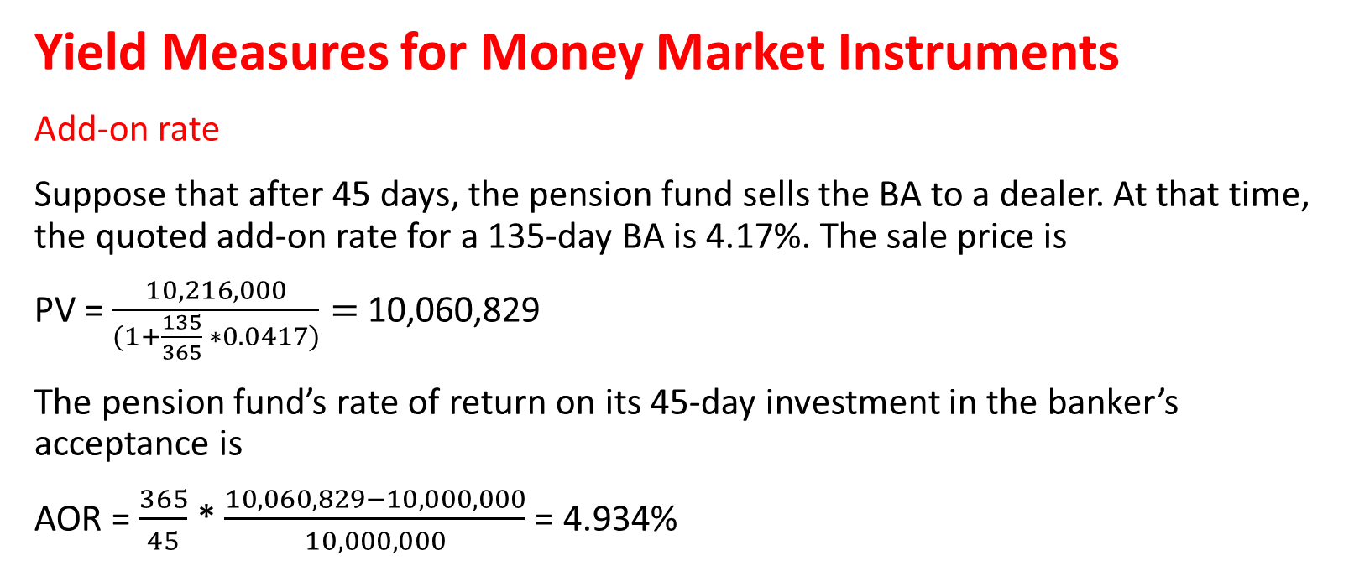
Module3 Introduction to fixed-income valuation
Yield Measures for Money Market Instruments
Add-on rate
Suppose that after 45 days, the pension fund sells the BA to a dealer. At that time, the quoted add-on rate for a 135-day BA is 4.17%. The sale price is
PV = $\frac{10,216,000}{(1+\frac{135}{365} ∗0.0417)}=$10,060,829
The pension fund’s rate of return on its 45-day investment in the banker’s acceptance is
AOR = $\frac{365}{45}$ * $\frac{10,060,829−10,000,000}{10,000,000}$ = 4.934%

Slide 116
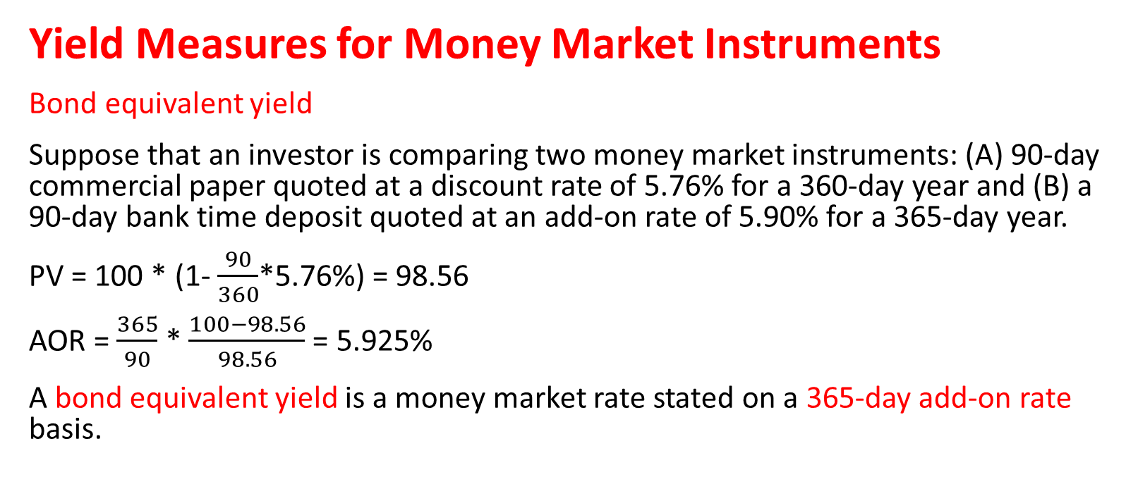
Module3 Introduction to fixed-income valuation
Yield Measures for Money Market Instruments
Bond equivalent yield
Suppose that an investor is comparing two money market instruments: (A) 90-day commercial paper quoted at a discount rate of 5.76% for a 360-day year and (B) a 90-day bank time deposit quoted at an add-on rate of 5.90% for a 365-day year.
PV = 100 * (1- $\frac{90}{360}$*5.76%) = 98.56
AOR = $\frac{365}{90}$ * $\frac{100−98.56}{98.56}$ = 5.925%
A bond equivalent yield is a money market rate stated on a 365-day add-on rate basis.

Slide 117
practices
Suppose that a money market investor observes quoted rates on the following four 180-day money market instruments:
Calculate the bond equivalent yield for each instrument. Which instrument offers the investor the highest rate of return if the credit risks are the same?
Money market instrument | Quotation Basis | Assumed number of days in the year | Quoted rate
A | Discount rate | 360 | 4.33%
B | Discount rate | 365 | 4.36%
C | Add on rate | 360 | 4.35%
D | Add on rate | 365 | 4.45%

Slide 118
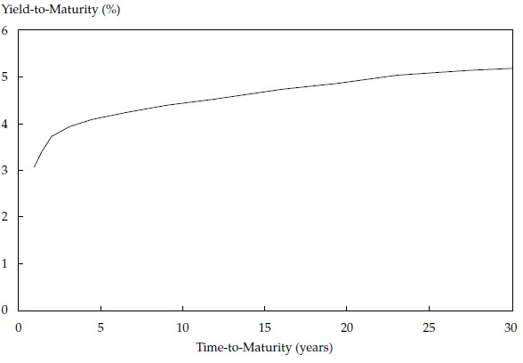
Module3 Introduction to fixed-income valuation
The maturity structure of interest rates
Spot curve
The spot, zero, or strip curve is a
sequence of yields-to-maturity
on zero-coupon bonds.

Slide 119
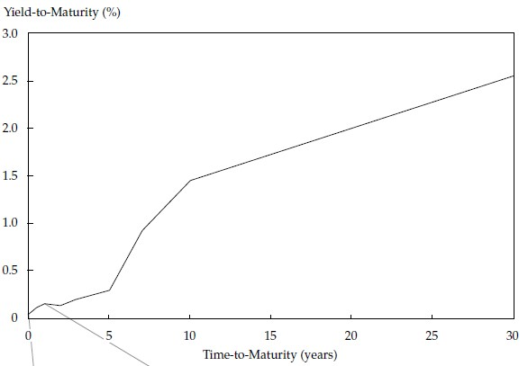
Module3 Introduction to fixed-income valuation
The maturity structure of interest rates
Yield curve on coupon bonds
Analysts usually use only the
most recently issued and
actively traded government
bonds to build a yield curve

Slide 120
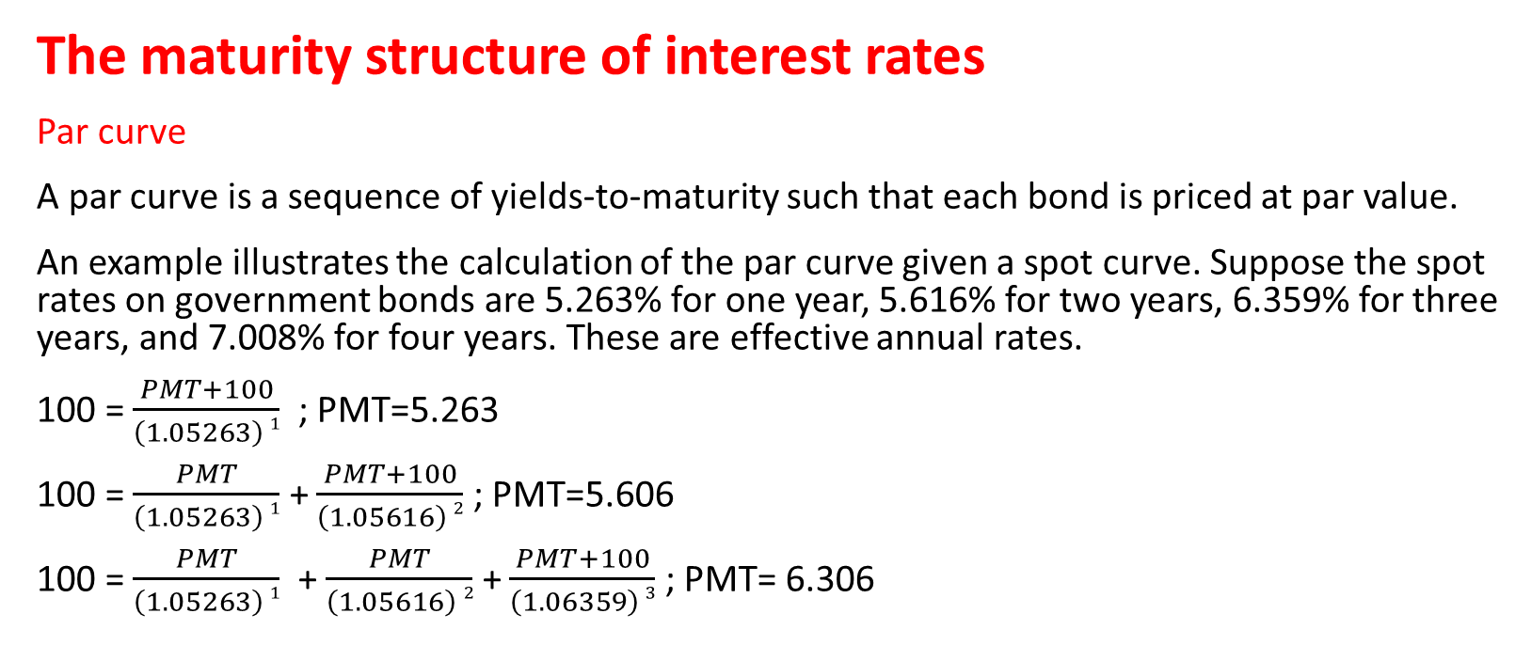
Module3 Introduction to fixed-income valuation
The maturity structure of interest rates
Par curve
A par curve is a sequence of yields-to-maturity such that each bond is priced at par value.
An example illustrates the calculation of the par curve given a spot curve. Suppose the spot rates on government bonds are 5.263% for one year, 5.616% for two years, 6.359% for three years, and 7.008% for four years. These are effective annual rates.
100 = $\frac{PMT+100}{\left(1.05263\right) 1}$ ; PMT=5.263
100 = $\frac{PMT}{\left(1.05263\right) 1}$ + $\frac{PMT+100}{\left(1.05616\right) 2}$ ; PMT=5.606
100 = $\frac{PMT}{\left(1.05263\right) 1}$ + $\frac{PMT}{\left(1.05616\right) 2}$ + $\frac{PMT+100}{\left(1.06359\right) 3}$ ; PMT= 6.306

Slide 121
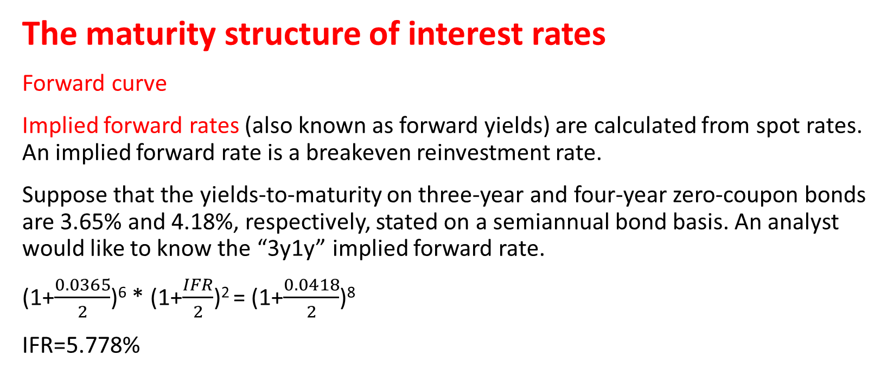
Module3 Introduction to fixed-income valuation
The maturity structure of interest rates
Forward curve
Implied forward rates (also known as forward yields) are calculated from spot rates. An implied forward rate is a breakeven reinvestment rate.
Suppose that the yields-to-maturity on three-year and four-year zero-coupon bonds are 3.65% and 4.18%, respectively, stated on a semiannual bond basis. An analyst would like to know the “3y1y” implied forward rate.
(1+$\frac{0.0365}{2}$)⁶ * (1+$\frac{IFR}{2}$)² = (1+$\frac{0.0418}{2}$)⁸
IFR=5.778%

Slide 122
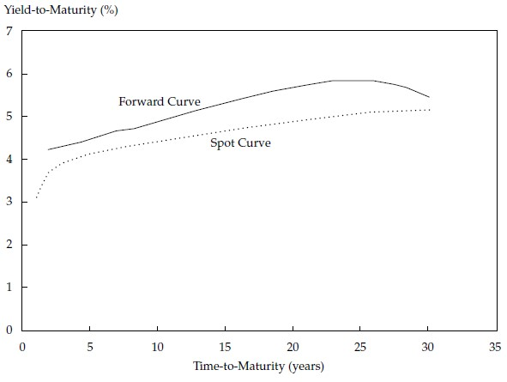
Module3 Introduction to fixed-income valuation
The maturity structure of interest rates
Forward curve
A forward curve is a series of
forward rates, each having the
same time frame.

Slide 123
Module3 Introduction to fixed-income valuation
The maturity structure of interest rates
Forward curve
Suppose that an analyst needs to value a four-year, 3.75% annual coupon payment bond that has the same risks as the bonds used to obtain the forward curve.
Time period | Forward rate
0y1y | 1.88%
1y1y | 2.77%
2y1y | 3.54%
3y1y | 4.12%

